Slide 1

CENG 336 INT. TO EMBEDDED SYSTEMS DEVELOPMENT Spring 2023-2024 ADC Recitation

Slide 2
OUTLINE
ADC (Analog-to-Digital Converter)

Slide 3
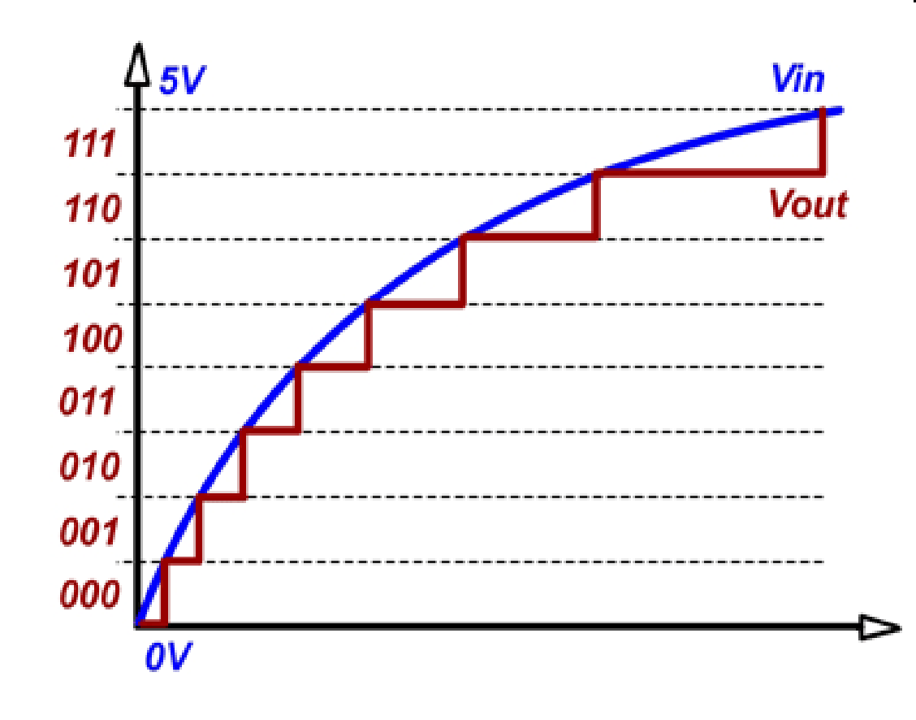
A/D CONVERSION
Digital output
In real world:
ANALOG signals
(the sensors used to monitor real world produce analog continuous voltage signals)
In computer world:
DIGITAL signals
5V
4.37V
3.75V
3.12V
2.50V
1.87V
1.25V
0.62V
Converted by ADC
Time
A 3-bit ADC

Slide 4
A/D MODULE in PIC18F8722
12/16 Analog input channels (64/80 pin device)
10-bit resolution
Software selectable reference voltages
Can generate interrupts after the conversion

Slide 5
REGISTERS
A/D Control Register0 (ADCON0)
Controls the operation of the A/D module
A/D Control Register1 (ADCON1)
Configures the functions of the port pins
A/D Control Register 2 (ADCON2)
Configures the A/D clock source, programmed acquisition time and justification.
A/D Result High Register (ADRESH)
A/D Result Low Register (ADRESL)

Slide 6
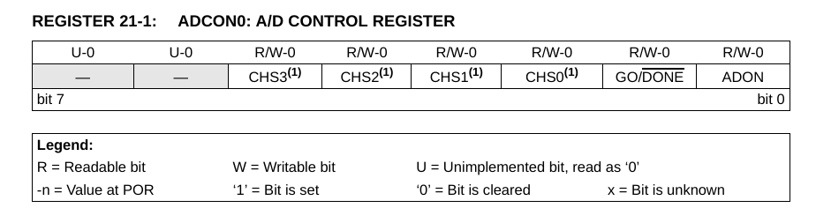
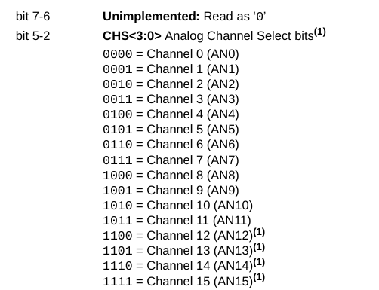
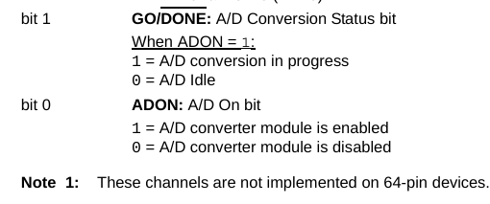
ADCON0

Slide 7
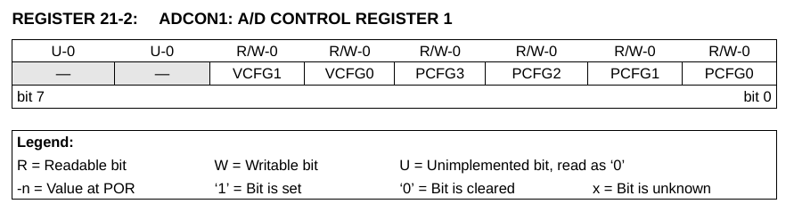
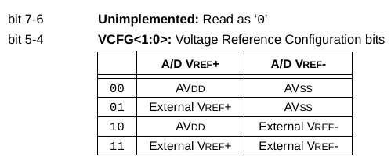
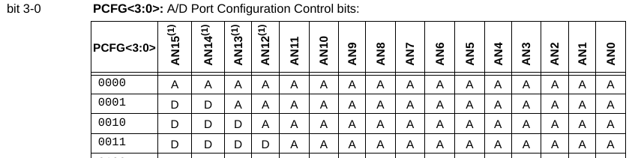
ADCON1

Slide 8
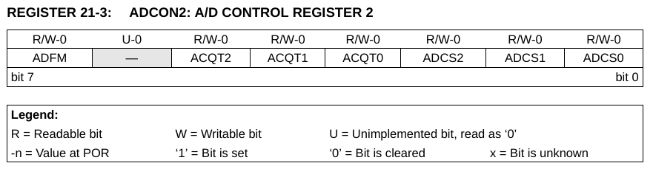
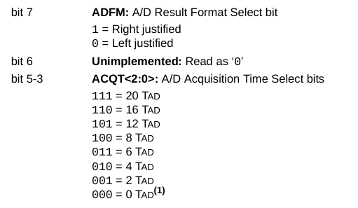
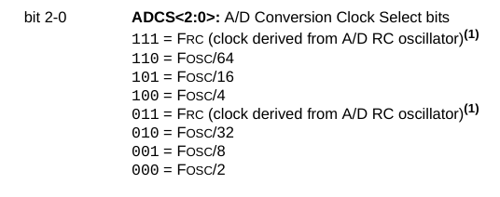
ADCON2

Slide 9
A/D CONVERSION RESULT
The ADRESH and ADRESL registers contain the result of the A/D conversion. When the A/D conversion is complete, the result is loaded into the ADRESH:ADRESL register pair, the GO/DONE bit (ADCON0 register) is cleared and A/D Interrupt Flag bit, ADIF (PIR1<6>), is set.

Slide 10
A/D CONVERSION RESULT
10-bit result
ADFM = 1
ADFM = 0
7 …..…………. 1 0 7 6 5 4 3 2 1 0
7 6 5 4 3 2 1 0 7 6 …………… 0
10-bit result
10-bit result
ADRESH ADRESL
ADRESH ADRESL
Right justified
Left justified

Slide 11
A/D MODULE OPERATION
The analog input charges a sample and hold capacitor to get a stable input voltage for the conversion.
The analog input is disconnected from the sample and hold capacitor to eliminate the wrong conversion results due to possible input voltage changes during the conversion.
The output of the sample and hold capacitor is the input into the converter.
The converter then generates a digital result of this analog level.

Slide 12
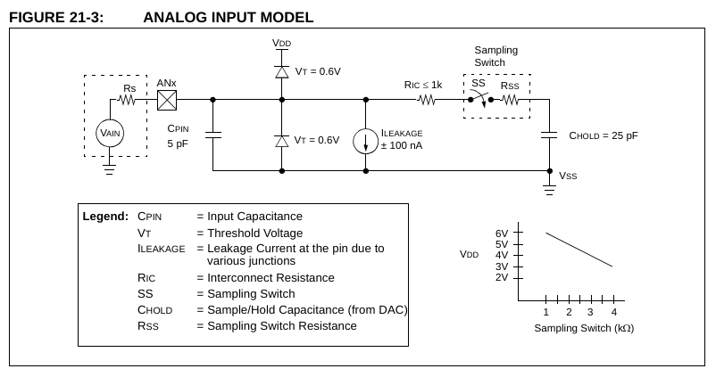
ANALOG INPUT MODEL

Slide 13
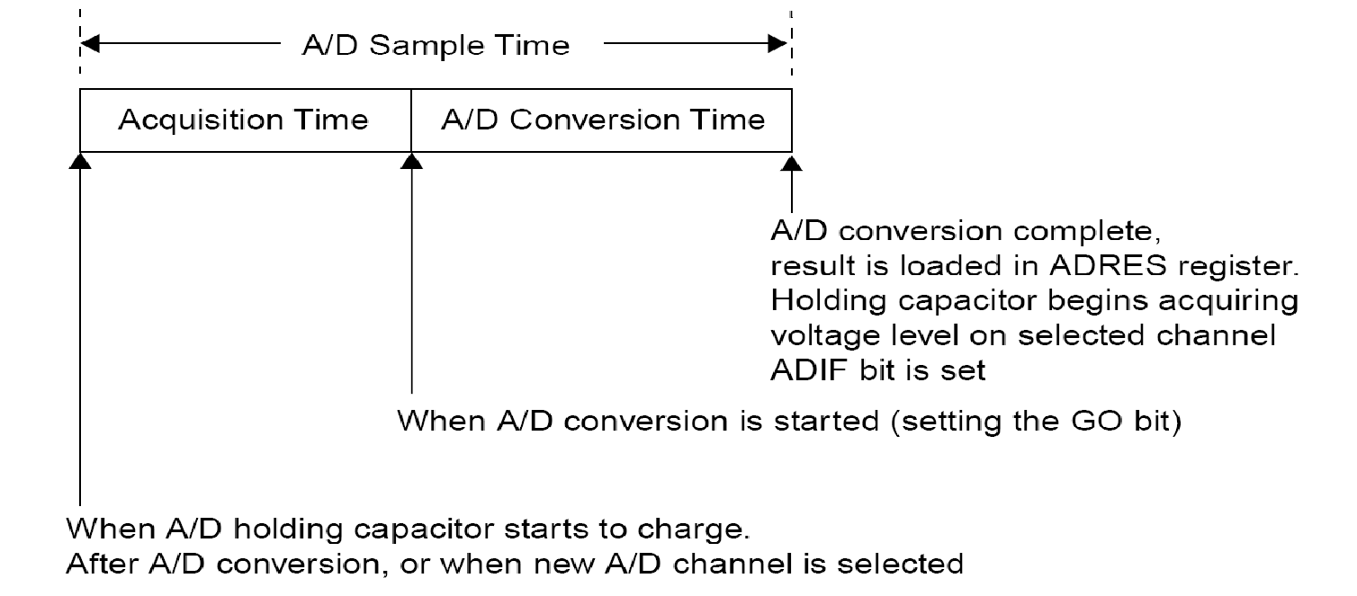
A/D ACQUISITION TIME REQ
There is a minimum acquisition time to ensure that the holding capacitor is charged to a level that will give the desired accuracy for the A/D conversion. Look at the data sheet for calculations, sections 21.1, 21.2, 21.3.

Slide 14
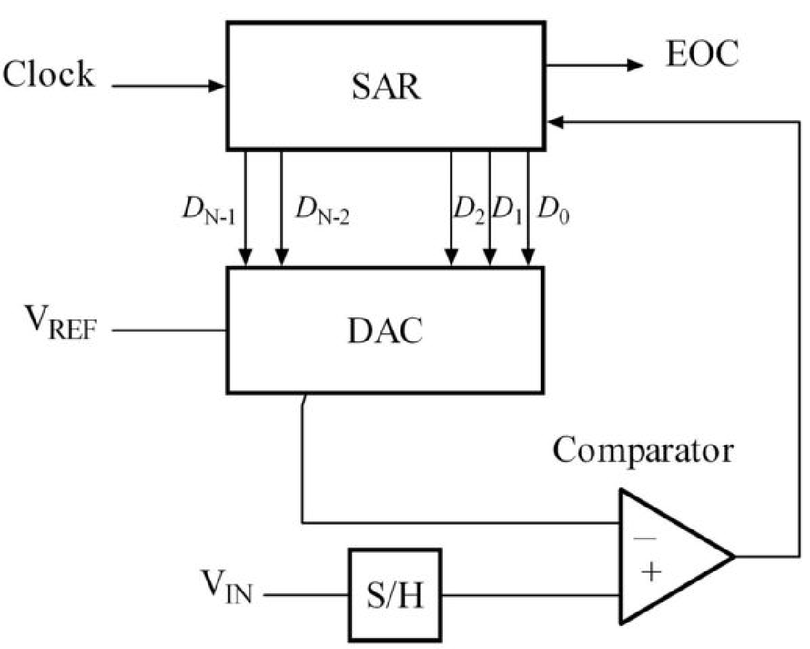
PIC18F8722 SUCCESSIVE APPROXIMATION ADC
The analog voltage level is converted to a digital value by performing iterative comparisons with a generated voltage reference value.
In each iterative step, a different voltage level is tested and depending on the comparison result the corresponding step bit is set or reset.
DAC = digital-to-analog converter
EOC = end of conversion
SAR = successive approximation register
S/H = sample and hold circuit
V_{IN} = input voltage
V_{REF} = reference voltage
Reference:
https://en.wikipedia.org/wiki/Successive-approximation_ADC
Notes:
NOTE Unknown source, the slide I took this from had this but the PIC18F8722 datasheet does not. The following slides are from Wikipedia so maybe this is too

Slide 15
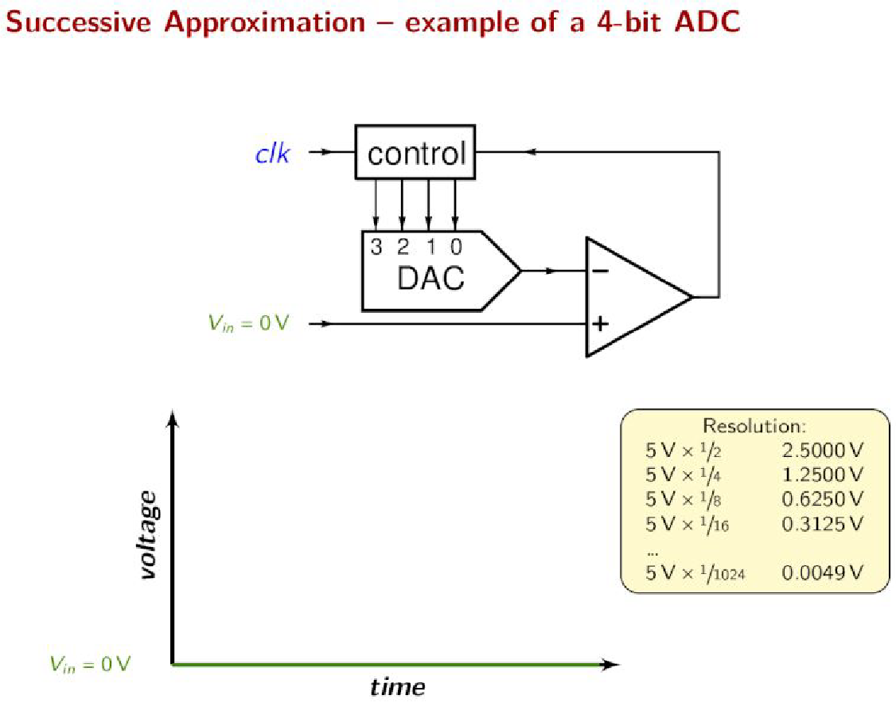
SUCCESSIVE APPROXIMATION ADC EXAMPLE - 1
Comparator outputs
1 when V+>V-,
otherwise 0.
Reference:
https://en.wikipedia.org/wiki/Successive-approximation_ADC

Slide 16
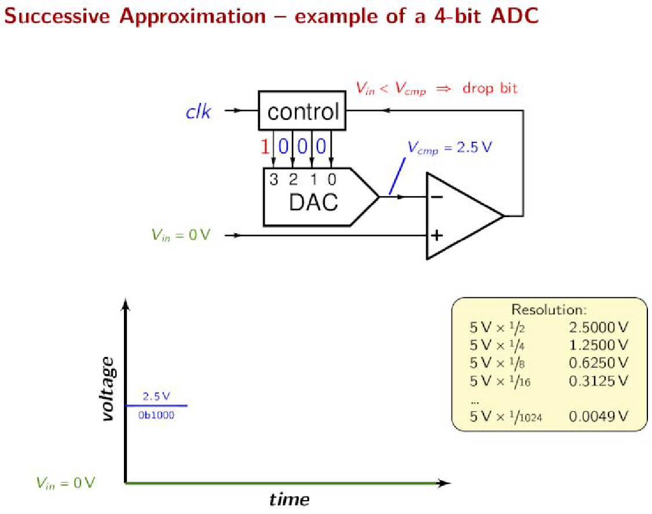
SUCCESSIVE APPROXIMATION ADC EXAMPLE - 1
Comparator outputs
1 when V+>V-,
otherwise 0.
Reference:
https://en.wikipedia.org/wiki/Successive-approximation_ADC

Slide 17
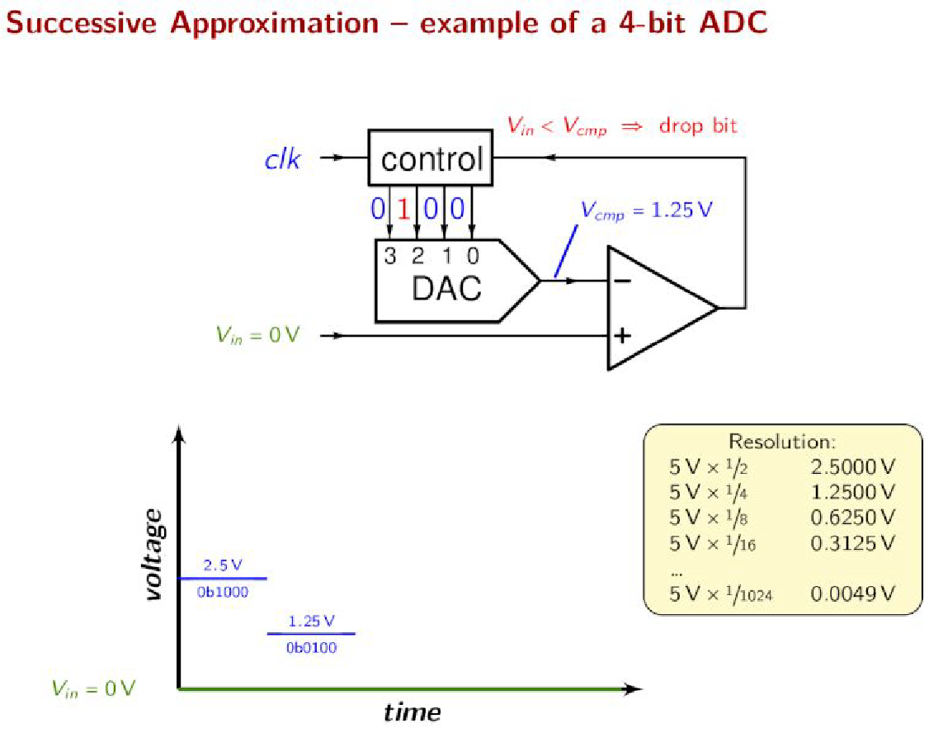
SUCCESSIVE APPROXIMATION ADC EXAMPLE - 1
Comparator outputs
1 when V+>V-,
otherwise 0.
Reference:
https://en.wikipedia.org/wiki/Successive-approximation_ADC

Slide 18
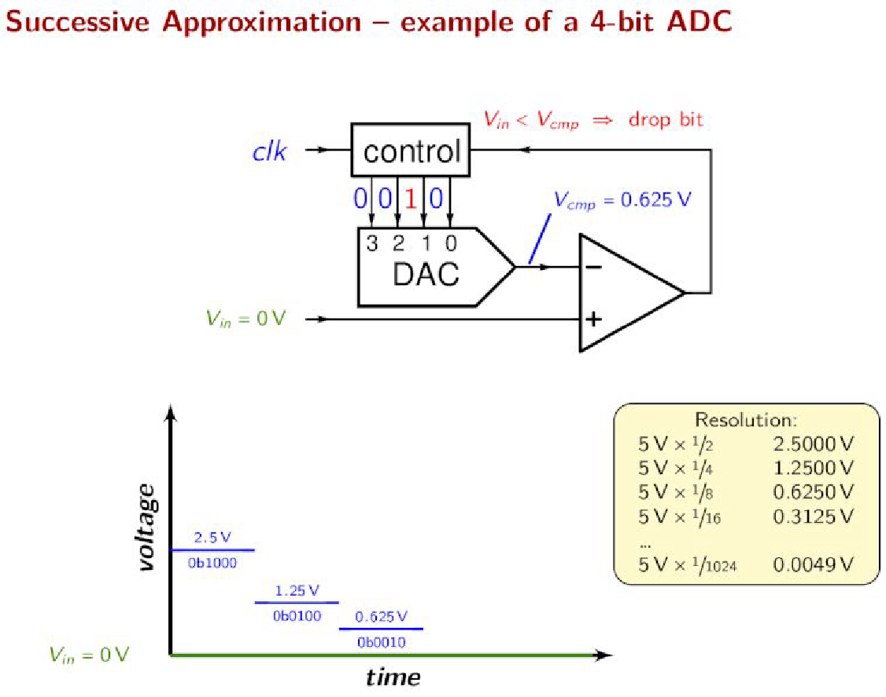
SUCCESSIVE APPROXIMATION ADC EXAMPLE - 1
Comparator outputs
1 when V+>V-,
otherwise 0.
Reference:
https://en.wikipedia.org/wiki/Successive-approximation_ADC

Slide 19
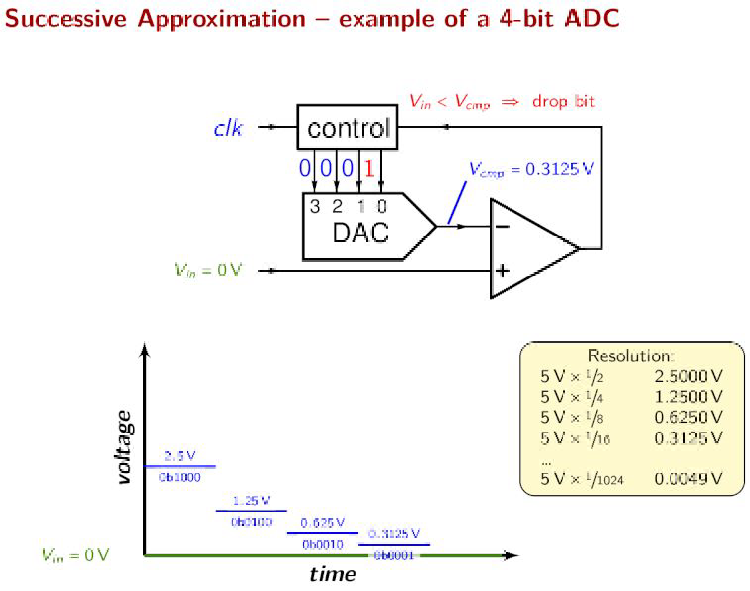
SUCCESSIVE APPROXIMATION ADC EXAMPLE - 1
Comparator outputs
1 when V+>V-,
otherwise 0.
Reference:
https://en.wikipedia.org/wiki/Successive-approximation_ADC

Slide 20
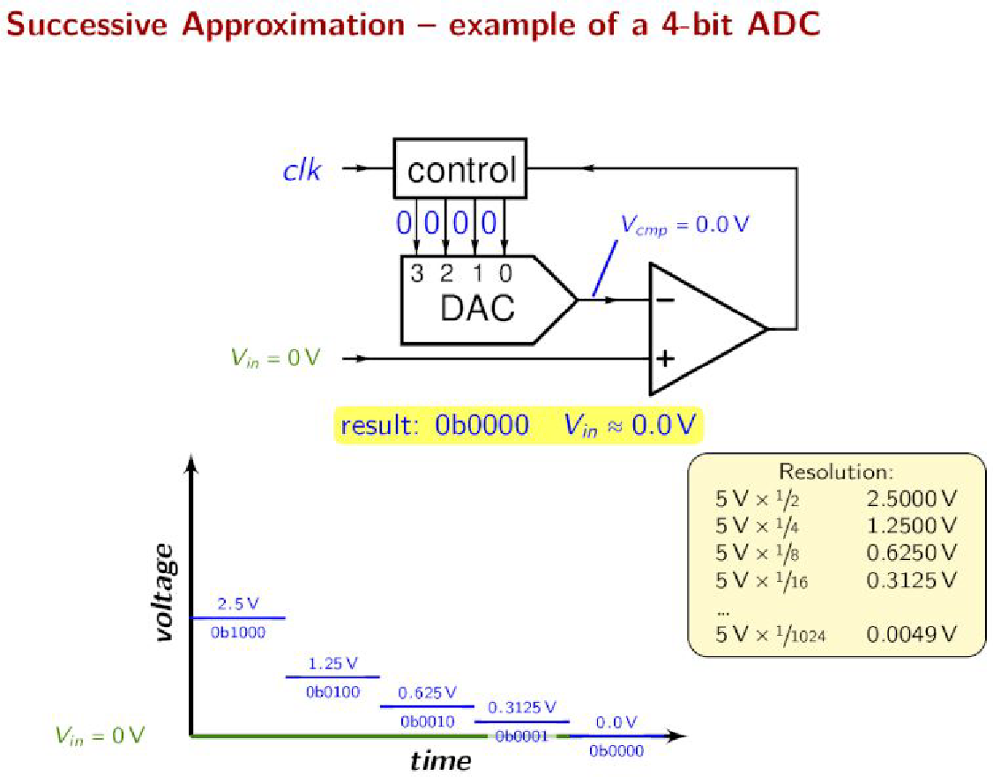
SUCCESSIVE APPROXIMATION ADC EXAMPLE - 1
Comparator outputs
1 when V+>V-,
otherwise 0.
Reference:
https://en.wikipedia.org/wiki/Successive-approximation_ADC

Slide 21
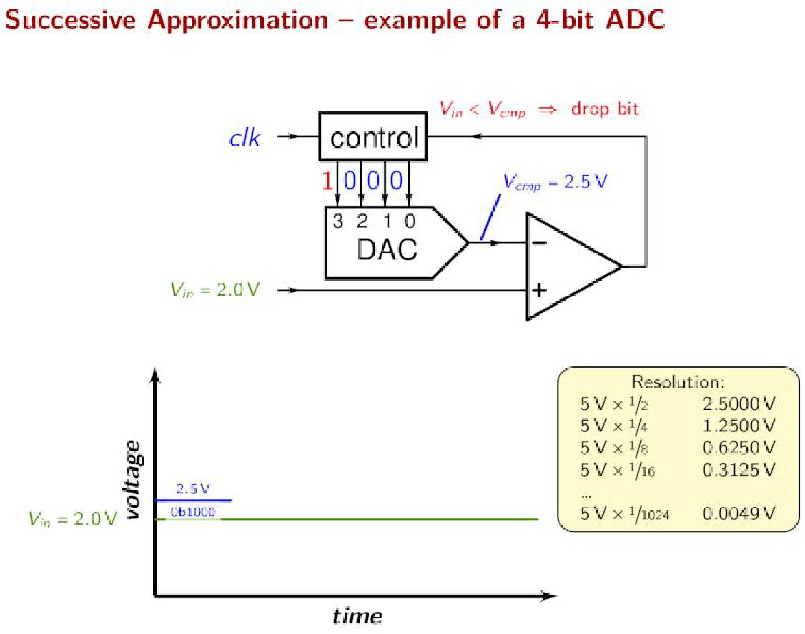
SUCCESSIVE APPROXIMATION ADC EXAMPLE - 2
Comparator outputs
1 when V+>V-,
otherwise 0.
Reference:
https://en.wikipedia.org/wiki/Successive-approximation_ADC

Slide 22
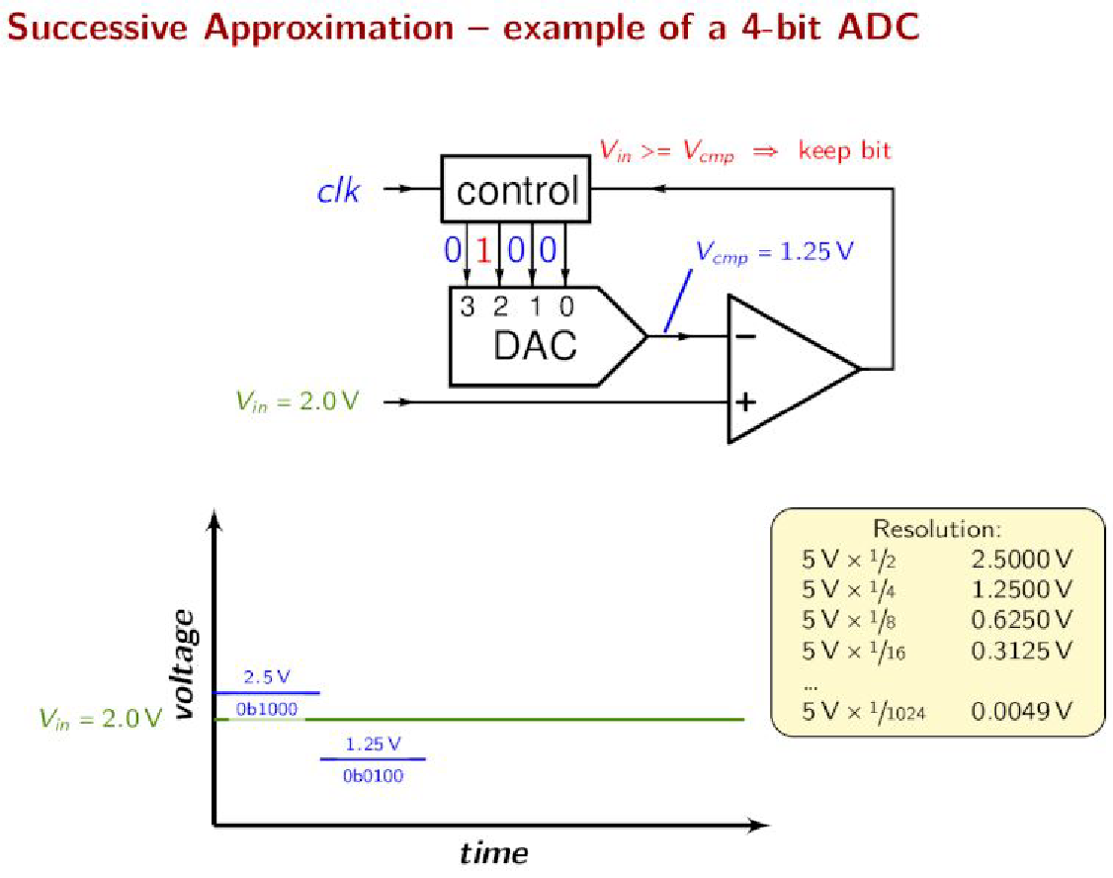
SUCCESSIVE APPROXIMATION ADC EXAMPLE - 2
Comparator outputs
1 when V+>V-,
otherwise 0.
Reference:
https://en.wikipedia.org/wiki/Successive-approximation_ADC

Slide 23
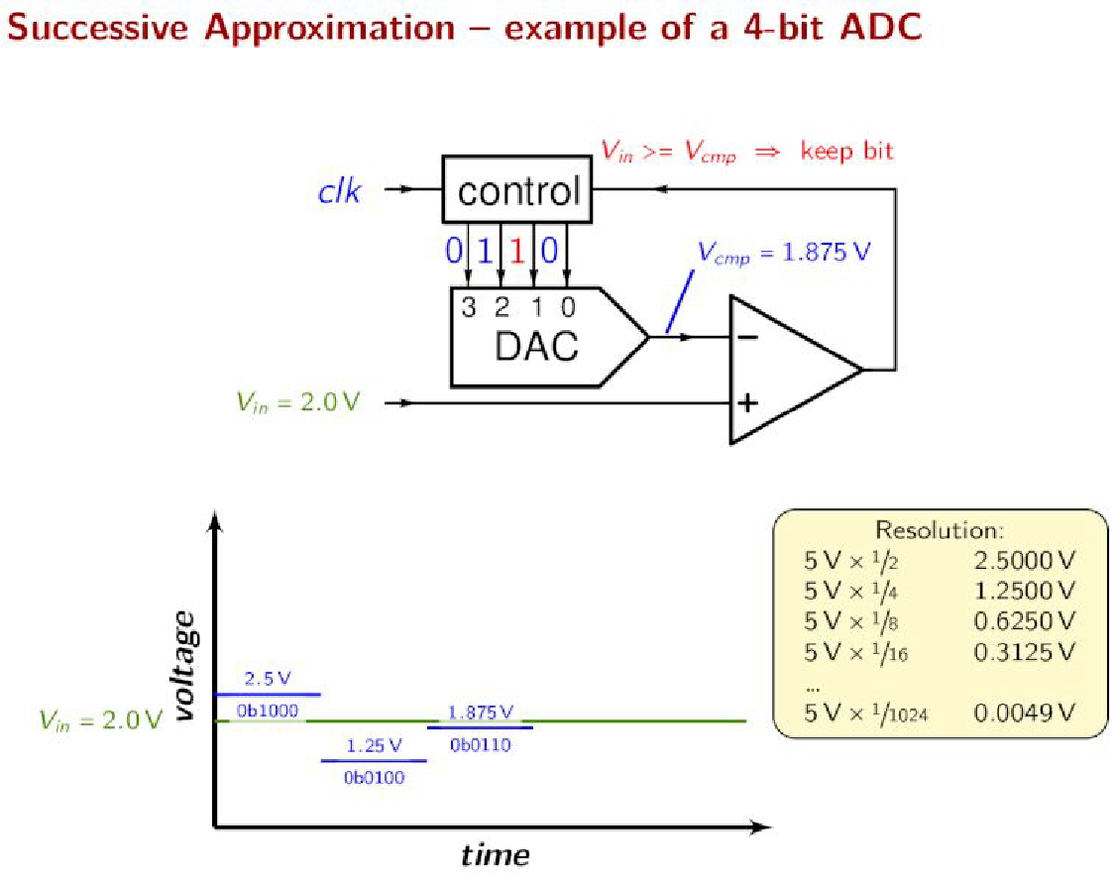
SUCCESSIVE APPROXIMATION ADC EXAMPLE - 2
Comparator outputs
1 when V+>V-,
otherwise 0.
Reference:
https://en.wikipedia.org/wiki/Successive-approximation_ADC

Slide 24
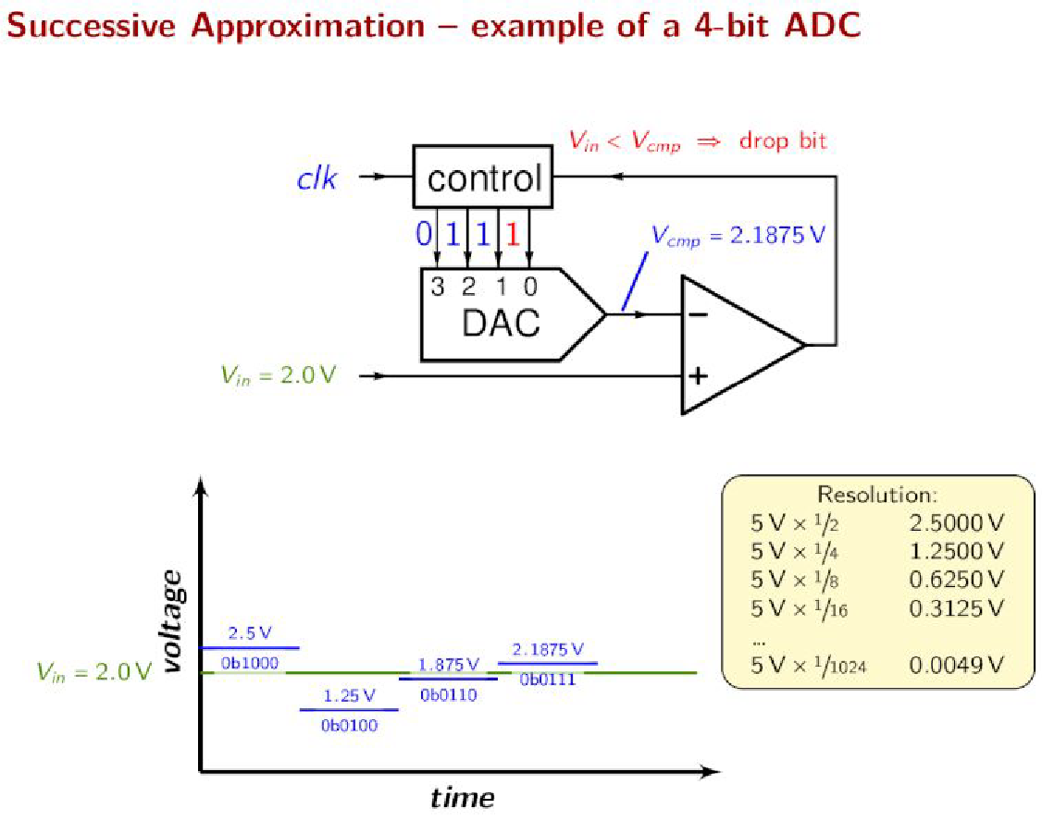
SUCCESSIVE APPROXIMATION ADC EXAMPLE - 2
Comparator outputs
1 when V+>V-,
otherwise 0.
Reference:
https://en.wikipedia.org/wiki/Successive-approximation_ADC

Slide 25
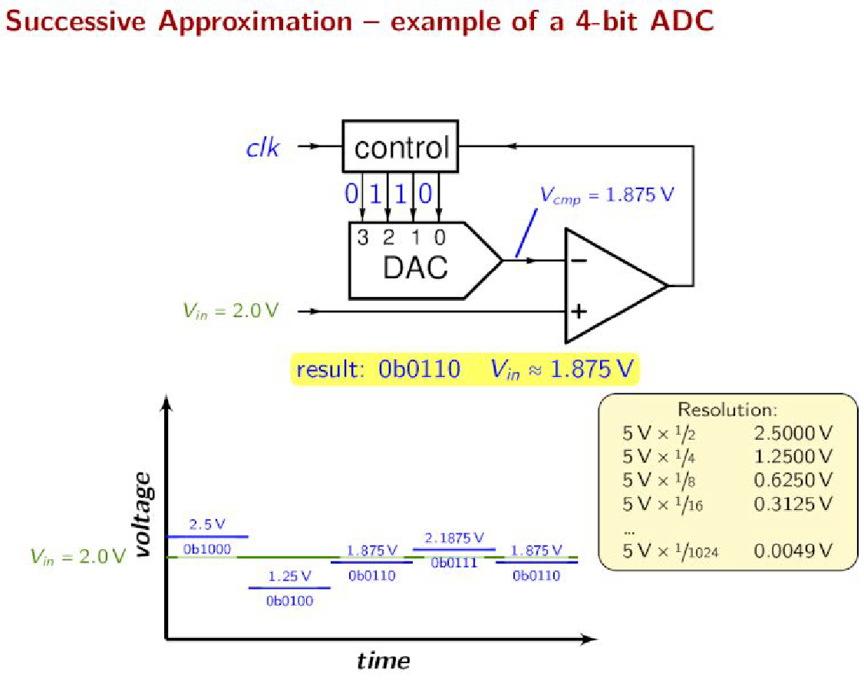
SUCCESSIVE APPROXIMATION ADC EXAMPLE - 2
Comparator outputs
1 when V+>V-,
otherwise 0.
Reference:
https://en.wikipedia.org/wiki/Successive-approximation_ADC

Slide 26
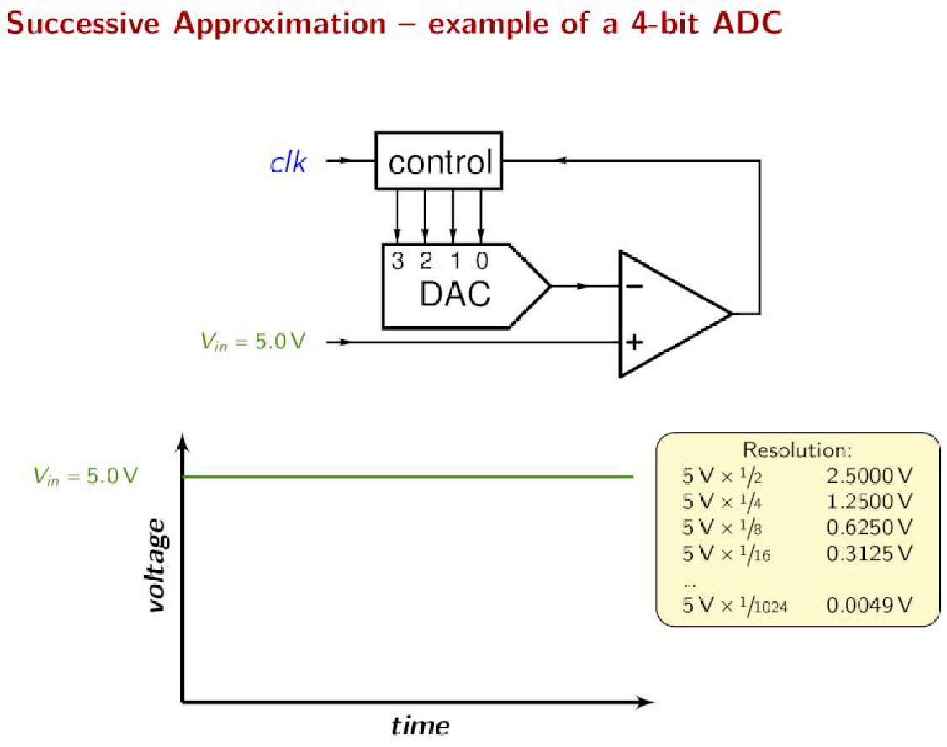
SUCCESSIVE APPROXIMATION ADC EXAMPLE - 3
Comparator outputs
1 when V+>V-,
otherwise 0.
Reference:
https://en.wikipedia.org/wiki/Successive-approximation_ADC

Slide 27
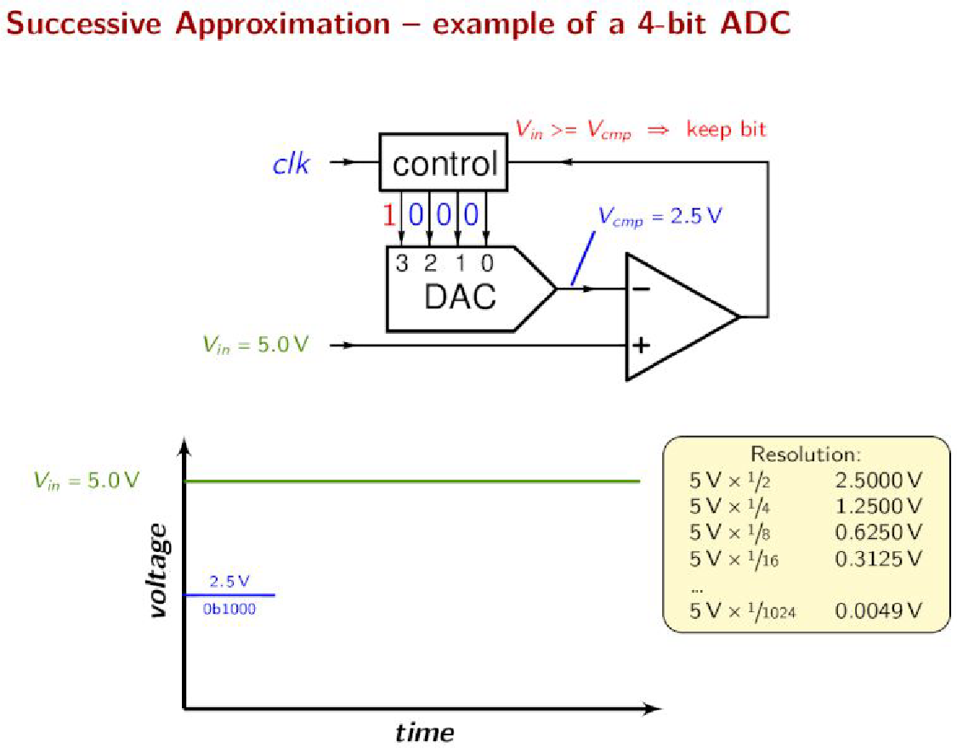
SUCCESSIVE APPROXIMATION ADC EXAMPLE - 3
Comparator outputs
1 when V+>V-,
otherwise 0.
Reference:
https://en.wikipedia.org/wiki/Successive-approximation_ADC

Slide 28
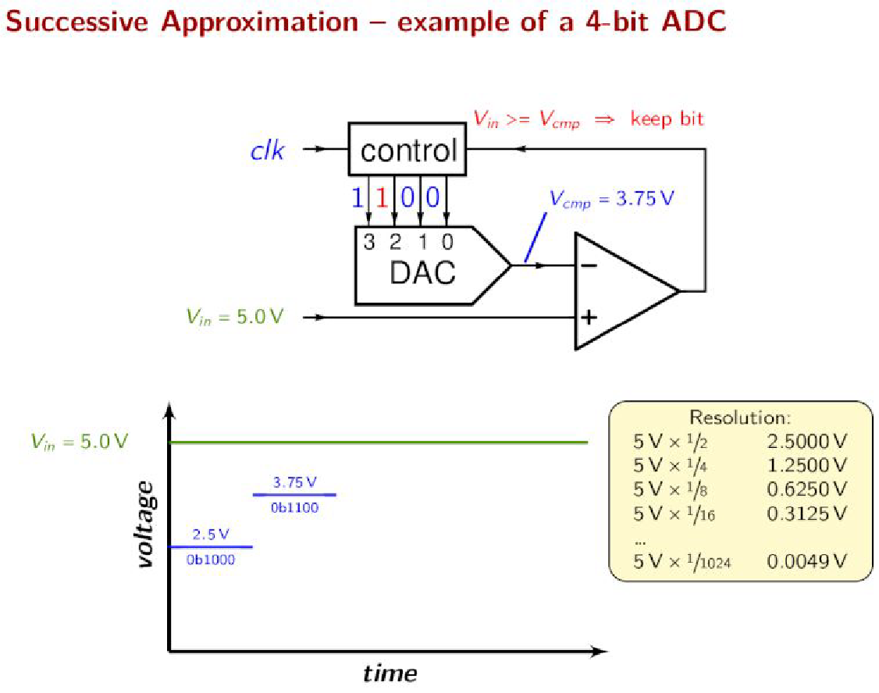
SUCCESSIVE APPROXIMATION ADC EXAMPLE - 3
Comparator outputs
1 when V+>V-,
otherwise 0.
Reference:
https://en.wikipedia.org/wiki/Successive-approximation_ADC

Slide 29
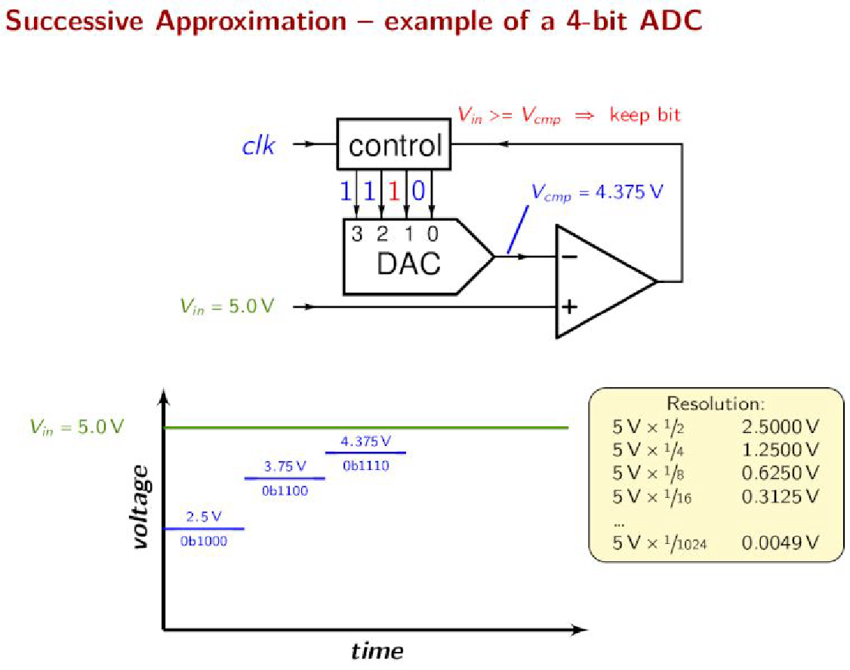
SUCCESSIVE APPROXIMATION ADC EXAMPLE - 3
Comparator outputs
1 when V+>V-,
otherwise 0.
Reference:
https://en.wikipedia.org/wiki/Successive-approximation_ADC

Slide 30
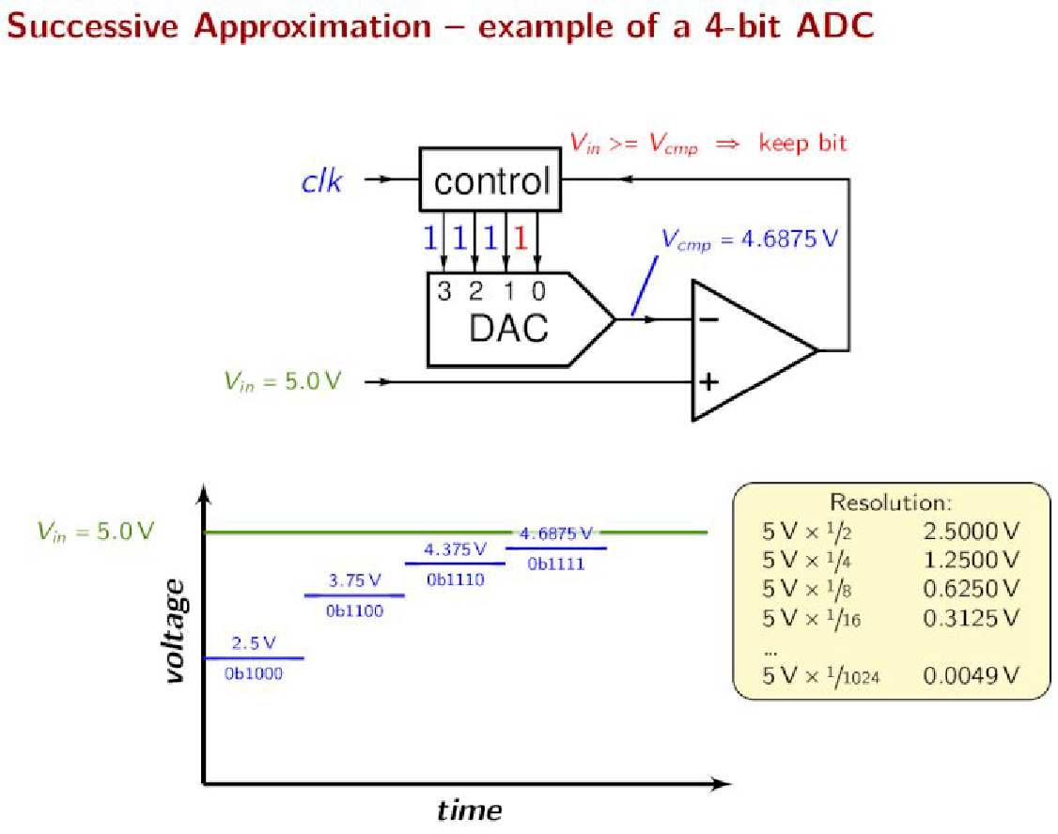
SUCCESSIVE APPROXIMATION ADC EXAMPLE - 3
Comparator outputs
1 when V+>V-,
otherwise 0.
Reference:
https://en.wikipedia.org/wiki/Successive-approximation_ADC

Slide 31
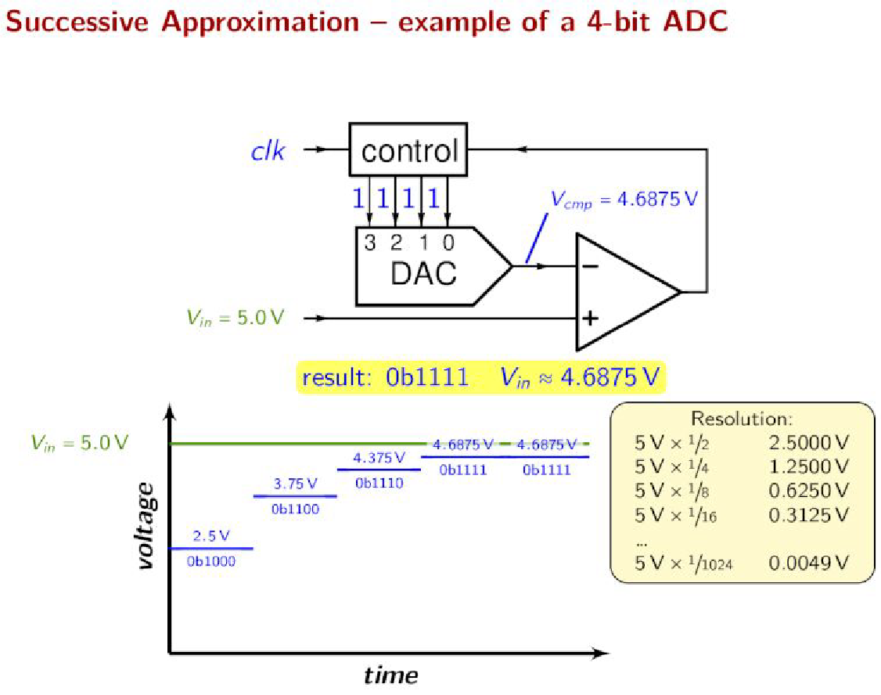
SUCCESSIVE APPROXIMATION ADC EXAMPLE - 3
Comparator outputs
1 when V+>V-,
otherwise 0.
Reference:
https://en.wikipedia.org/wiki/Successive-approximation_ADC

Slide 32
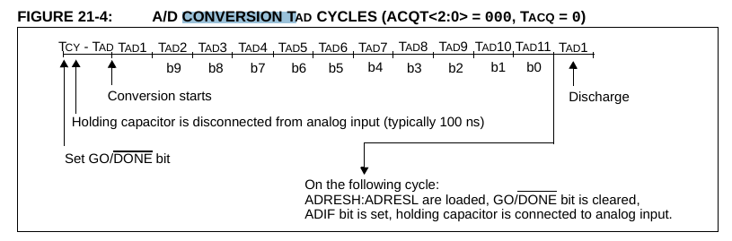
A/D CONVERSION T_{AD} CYCLES
The A/D conversion time per bit is defined as T_{AD}.
The A/D conversion requires 11 T_{AD} per 10-bit conversion.
After the A/D conversion is completed or aborted, a 2 TAD wait is required before the next acquisition can be started
TCY : instruction cycle

Slide 33
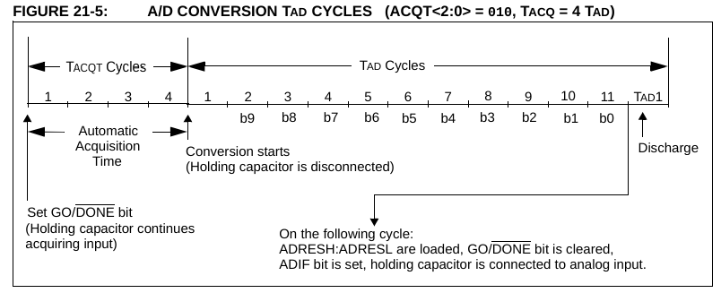
A/D CONVERSION T_{AD} CYCLES

Slide 34
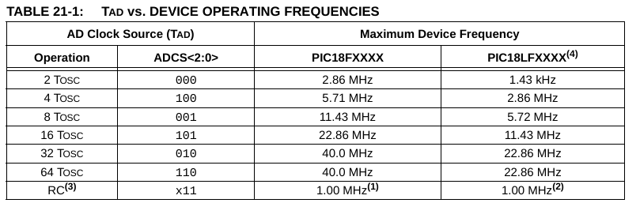
SELECTING A/D CONVERSION CLOCK
The seven possible options for TAD are: RC, 2T_{OSC}, 4T_{OSC}, 8T_{OSC}, 16T_{OSC}, 32T_{OSC}, 64T_{OSC}
,
For correct A/D conversions, the A/D conversion clock (T_{AD}) must be as short as possible (e.g. hold capacitor may discharge more), but greater than the minimum TAD (min 0.7 μs, max 25.0 μs (TOSC based, V REF ≥ 3.0V)). See parameter 130, Table 28-27 for more information.

Slide 35
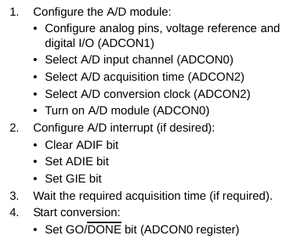
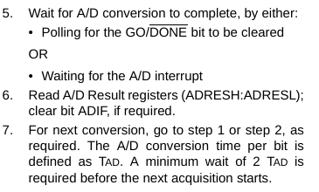
A/D MODULE OPERATION
See the notes on the next page ->

Slide 36
A/D MODULE OPERATION
The analog input channels must have their corresponding TRIS bits selected as inputs.
When the A/D conversion is complete, the result is loaded into the ADRESH:ADRESL register pair, the GO/DONE bit (ADCON0 register) is cleared and A/D Interrupt Flag bit, ADIF (PIR1<6>), is set.
If acquisition time is programmed (ACQT2:ACQT0 bit, ADCON2<5:3>), as soon as the GO/DONE is set A/D module continues to sample the selected input for the programmed acquisition time then it starts the conversion.
If acquisition time is not programmed, it is in the responsibility of the user to ensure that sufficient time passes after the selecting the analog input for input sampling. Then the user can initiate the conversion by setting the GO/DONE bit. Programming the acquisiton time exempts the user from handling the correct action time.
Notes:
FIXME Final point

Slide 37
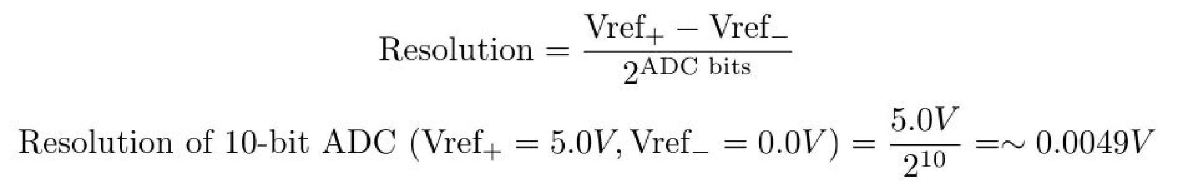
A/D MODULE SOME NOTES
Resolution indicates the minimum voltage level that an ADC is sensitive to.
The GO/DONE bit should NOT be set in the same instruction that turns on the A/D, due to the required acquisition time requirement.
If the TRIS bit is cleared (output), the digital output level (VOH or VOL) will be converted.

Slide 38
EXAMPLE

Slide 39
